Slide 1

Adapter Design Pattern
Bridging Incompatible Interfaces in Java
Presented by Joshua Dmello, Krish Surti, Manav Parmar

Slide 2
The Integration Challenge
The Problem
Real-World Scenario
Modern applications frequently integrate third-party libraries and legacy systems. But what happens when interfaces don't match?
Client Expects
pay(int amount)
Client code expects one method signature, while existing classes provide completely different interfaces.
Library Provides
makePayment(double money)
Without modification, these interfaces cannot communicate directly.

Slide 3




The Adapter Solution
Client Code
Adapter Layer
Existing Class
Calls expected interface
Translates requests
Executes using its own interface
The Adapter Pattern acts as a translator, converting one interface into another without modifying either the client or the existing class.

Slide 4




Pattern Components
Client
Target Interface
Uses the Target interface to make requests
Defines the domain-specific interface that Client expects
Adapter
Adaptee
Implements Target and translates calls to Adaptee
Existing class with incompatible interface

Slide 5
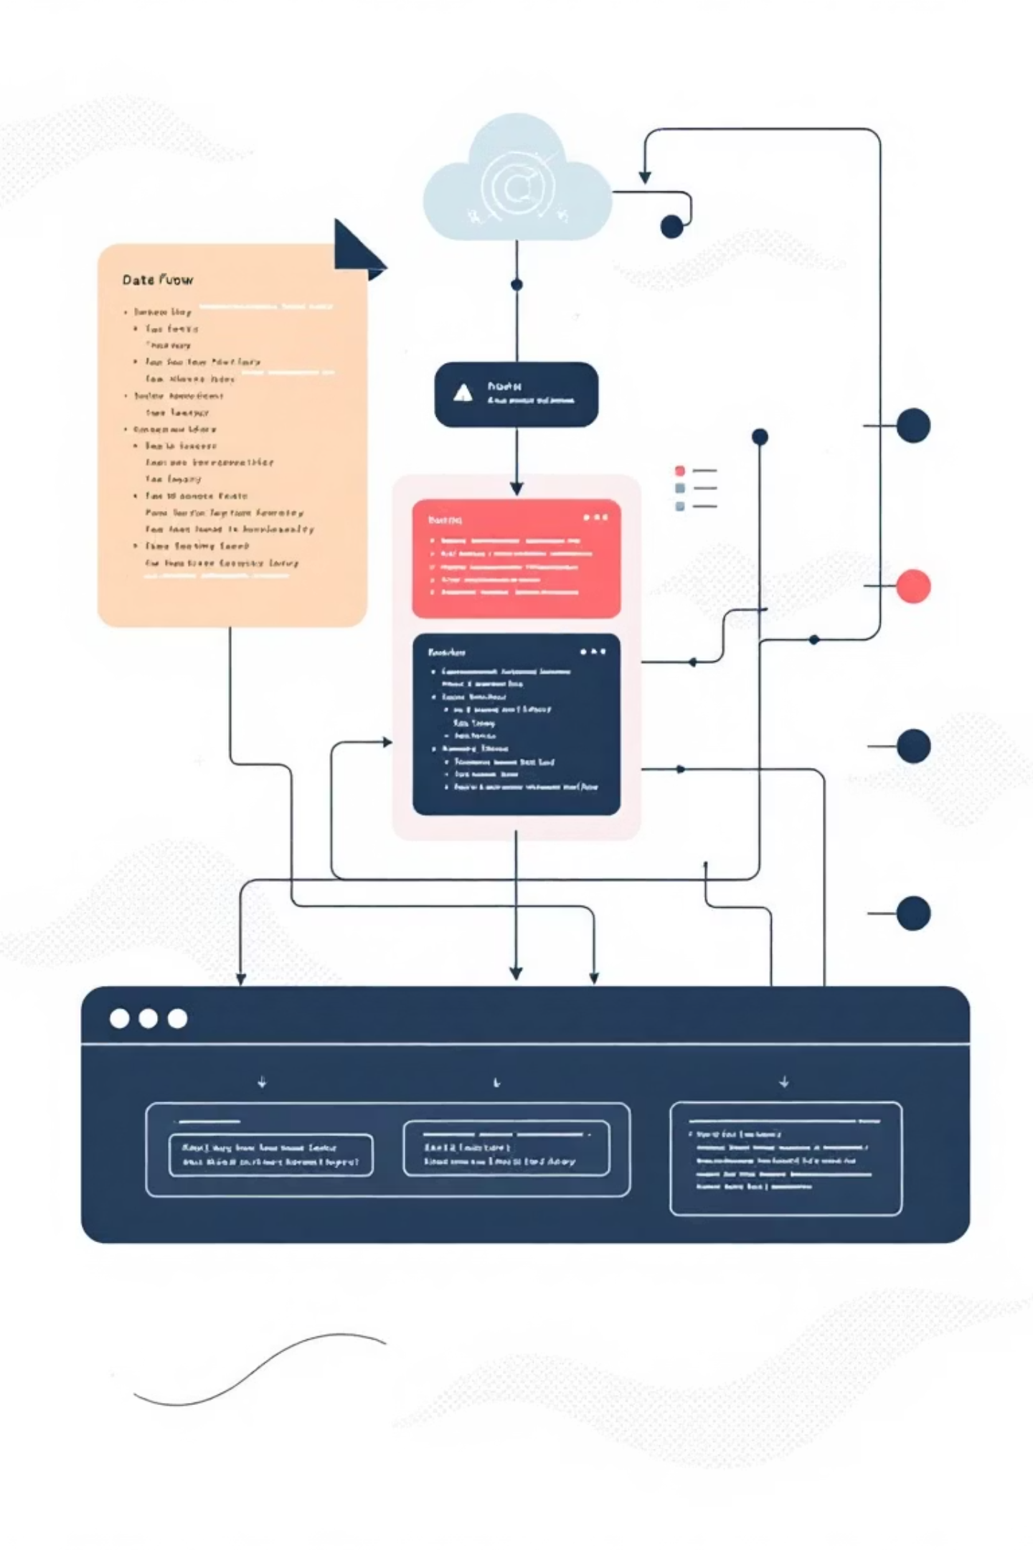
How It Works: The Flow
01
Client initiates request
Calls method on Target interface
02
Adapter receives call
Implements Target interface methods
03
Request translation
Converts parameters and method signatures
04
Adaptee executes
Performs actual work using its native interface
The client remains completely unaware of the Adaptee's existence, interacting only with the familiar Target interface.

Slide 6
Java Implementation
Target Interface
Adapter Implementation
interface PaymentProcessor {
void pay(int amount);
}
class RazorpayAdapter
implements PaymentProcessor {
private Razorpay razorpay;
public RazorpayAdapter() {
razorpay = new Razorpay();
}
public void pay(int amount) {
razorpay.makePayment(
(double) amount);
}
}
Adaptee Class
class Razorpay {
void makePayment(double money) {
System.out.println("Processing ₹"
+ money);
}
}
The adapter converts the integer amount to double and delegates to Razorpay's native method, creating seamless compatibility.

Slide 7

Key Benefits & Takeaways
Zero Client Modification
Client code remains unchanged, protecting existing functionality and reducing risk
Legacy Code Reuse
Integrate third-party libraries and legacy systems without rewriting them
Easy Extension
Add new adapters for different payment gateways: PayPalAdapter, StripeAdapter, etc.
Single Responsibility
Separation of interface conversion logic from business logic
The Adapter Pattern enables incompatible interfaces to collaborate by converting one interface into another that clients expect.

